Slide 1
Multi-species Classification for Dolphin and Whales: A Deep Learning Approach
CSCI-SHU 360 Machine Learning: Final Project
Bale Chen, Yuxuan Xia

Slide 2
Contents
Problem Description
Data Description
Data Preprocessing
Models
Small-sample Trial
Results & Discussion
Limitations and Future Work

Slide 3
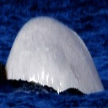
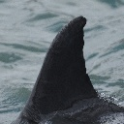
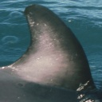
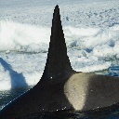
Species Identification
Train a model to classify 128x128 images of marine animals to 6 species:
Dolphin: Bottlenose Dolphin, Dusky Dolphin, Spinner Dolphin
Whales: Beluga, Blue Whale, Killer Whale
Reduce manual labor of identifying marine animal species
Beluga
Bottlenose Dolphin
Dusky Dolphin
Killer Whale
Notes:
In Marine Science, one of the challenges that scientists face is the identification of certain animal species. Most of the researchers still manually identify different species by eyes. Although experts have high accuracy in this task, it would save much time if it can be done by computers.

Slide 4
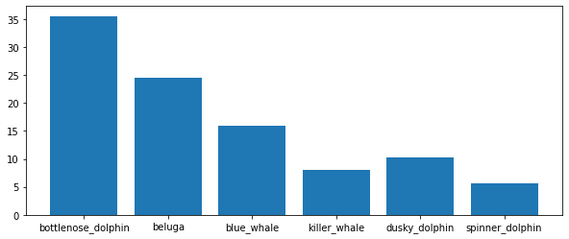
Data Description
Originally from “Happywhale - Whale and Dolphin Identification” Kaggle competition
Resized whale-dolphin images dataset (contributed by “RDIZZL3”)
30348 128x128 RGB standard Images
Mostly Fin and lateral part of whale/dolphin
Dusky Dolphin
Notes:
Realistic since that’s basically what you can see from the surface of the sea. That also means little information and hard to detect the useful information

Slide 5
Data Preprocessing
Data Cleaning
Data Splitting
Create Data Loader and Ready to go!
Typo Fixing
Selecting the desired species in the large dataset
80% Training
20% Validation
Create a oversampled training set
~10% Accuracy Decrease
with oversampling

Slide 6
Traditional ML Models
KNN
Decision Tree
Logistic Regression
Notes:
Three most common and basic models – Nearest Neighbor based, Tree Based, Linear Separator

Slide 7
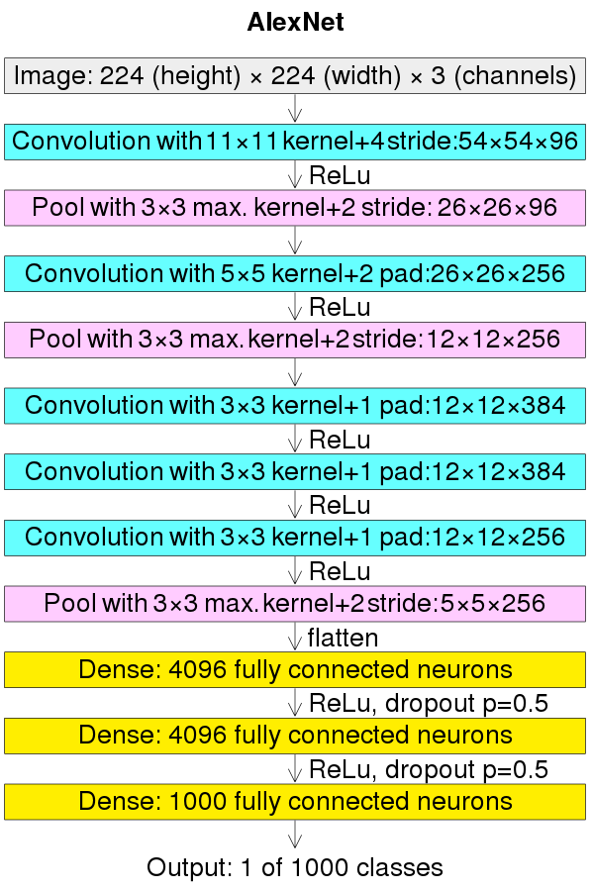
Neural Networks
AlexNet
Designed by Alex Krizhevsky in 2014
One of the foundational neural networks in computer vision
Image Reference: https://en.wikipedia.org/wiki/AlexNet
Notes:
Convolutional Neural Network with 5 convolutional layers with 2 max pooling layers in between, then followed by three fully connected layers with ReLU activation and dropout layer

Slide 8
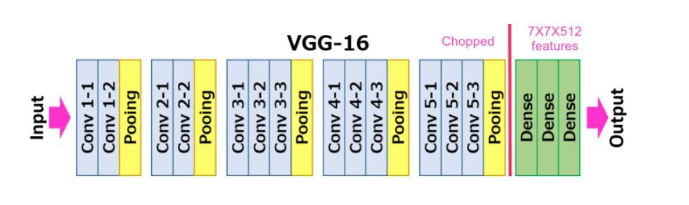
Neural Networks
VGG16
Designed by Simonyan and Zisserman
Another classic Deep Convolutional Neural Network
Image Reference: https://medium.com/analytics-vidhya/face-recognition-using-transfer-learning-and-vgg16-cf4de57b9154
Notes:
Convolutional Neural Network with 13 convolutional layers, 5 max pooling layers, and three fully connected layers
More convolutional layers than AlexNet

Slide 9
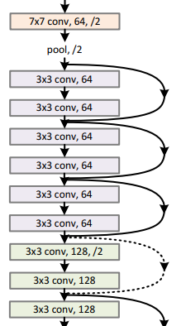
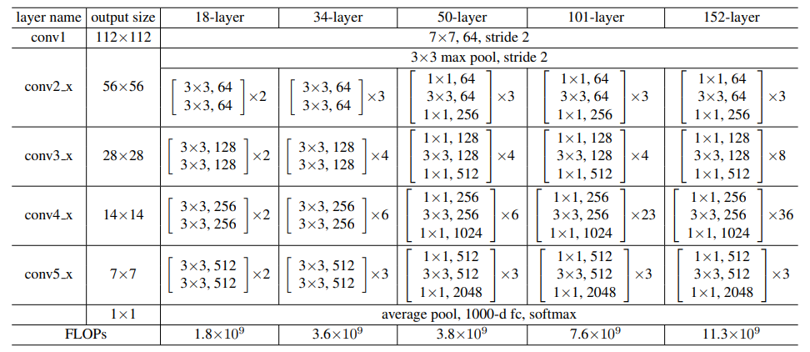
Advanced NNs
ResNet 50

Slide 10
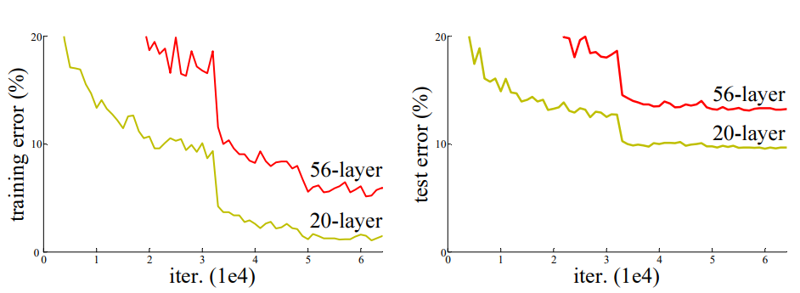
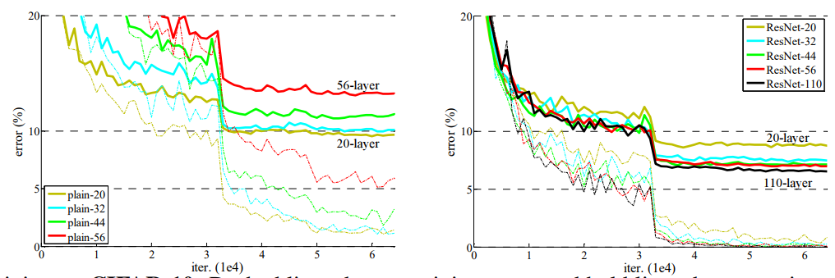
Advanced NNs
Why ResNet 50

Slide 11
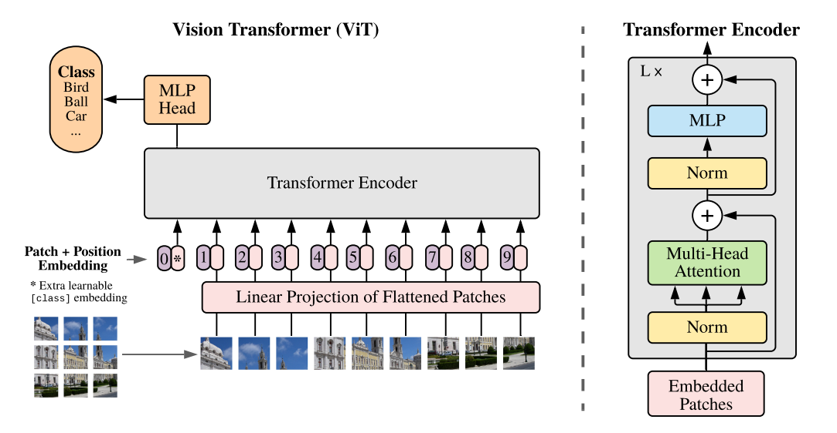
Advanced NNs
Vision Transformer

Slide 12
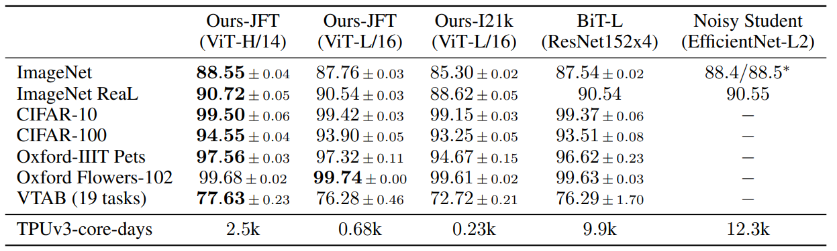
Advanced NNs
Why Vision Transformer

Slide 13
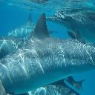
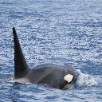
Small-sample Trial
3000 Train 1000 Test
bottlenose dolphin - 10781 samples 1500 Train 500 Test
killer whale - 2455 samples 1500 Train 500 Test

Slide 14
Comparison
Models | Accuracy
KNN | 80.9%
Decision Tree | 74.3%
Logistic Regression | 82.7%
Unexpected
Good Performance of Non-CNN models
ResNet 50 88.4%
ViT 79.3%

Slide 15
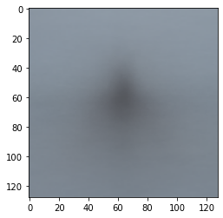
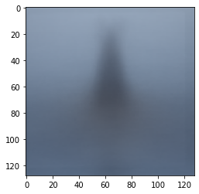
Why Traditional Models Performs so Good?
Simply take average of all images
Dolphin
Killer Whale

Slide 16
Baseline Performance
Models | Accuracy
KNN | 67.61%
Decision Tree | 62.14%
Logistic Regression | 73.73%
Notes:
Note that due to computational power limit, we only used ¼ of the dataset to train these models because the data was too large for our computer memory

Slide 17
Neural Networks that We Tested
Accuracy on Test Set
 | AlexNet | VGG16 | ResNet 50
Pretrained | 59.427% | 62.894% | 75.097%
Not Pretrained | 87.809% | 88.056% | 85.255%
Image Reference: https://en.wikipedia.org/wiki/AlexNet
Notes:
Didn’t pass the baseline 73.73% from logistic regression - Transfer learning is not working well on this task

Slide 18
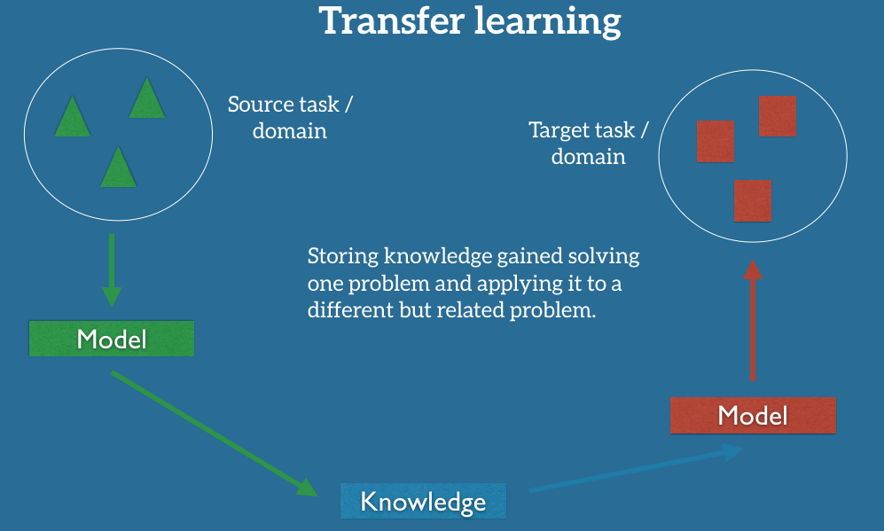
Discussion
Why Transfer Learning does not work?
Domain of the images are different. Our dataset has a different domain with how the pytorch models are pretrained (ImageNET)
Image Reference: https://ruder.io/transfer-learning/

Slide 19
Limitations and Future Work
More species can be included
Data Augmentation

Slide 20
Thank You!

Slide 21
References
Alexey Dosovitskiy, Lucas Beyer, Alexander Kolesnikov, Dirk Weissenborn, Xiaohua Zhai, Thomas Unterthiner, Mostafa Dehghani, Matthias Minderer, Georg Heigold, Sylvain Gelly, et al. An image is worth 16x16 words: Transformers for image recognition at scale. arXiv preprint arXiv:2010.11929, 2020.
B. Zhou, A. Khosla, A. Lapedriza, A. Oliva, and A. Torralba. Learning deep features for discriminative localization. In Proceedings of the IEEE Conference on Computer Vision and Pattern Recognition.
Kaiming He, Xiangyu Zhang, Shaoqing Ren, and Jian Sun. Deep residual learning for image recognition. In CVPR, 2016.
Simonyan, Karen, Vedaldi, Andrea, and Zisserman, Andrew. Deep inside convolutional networks: Visualising image classification models and saliency maps. CoRR, 2013.

